Slide 1
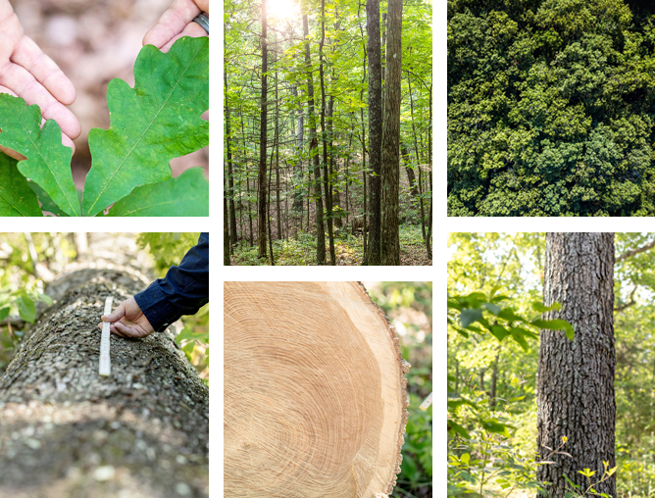
What is the Difference?
BETWEEN FRENCH AND AMERICAN OAK
Each oak species offers different nuances – American oak contains more lactones than French oak, while French oak has more tannins than American oak.
Both species have similar potential for the creation of vanillin and the caramelization of wood sugars. American oak is known for being slightly creamier, whereas French oak is known for being slightly spicier.
Courtesy of Cooperages 1912

Slide 2
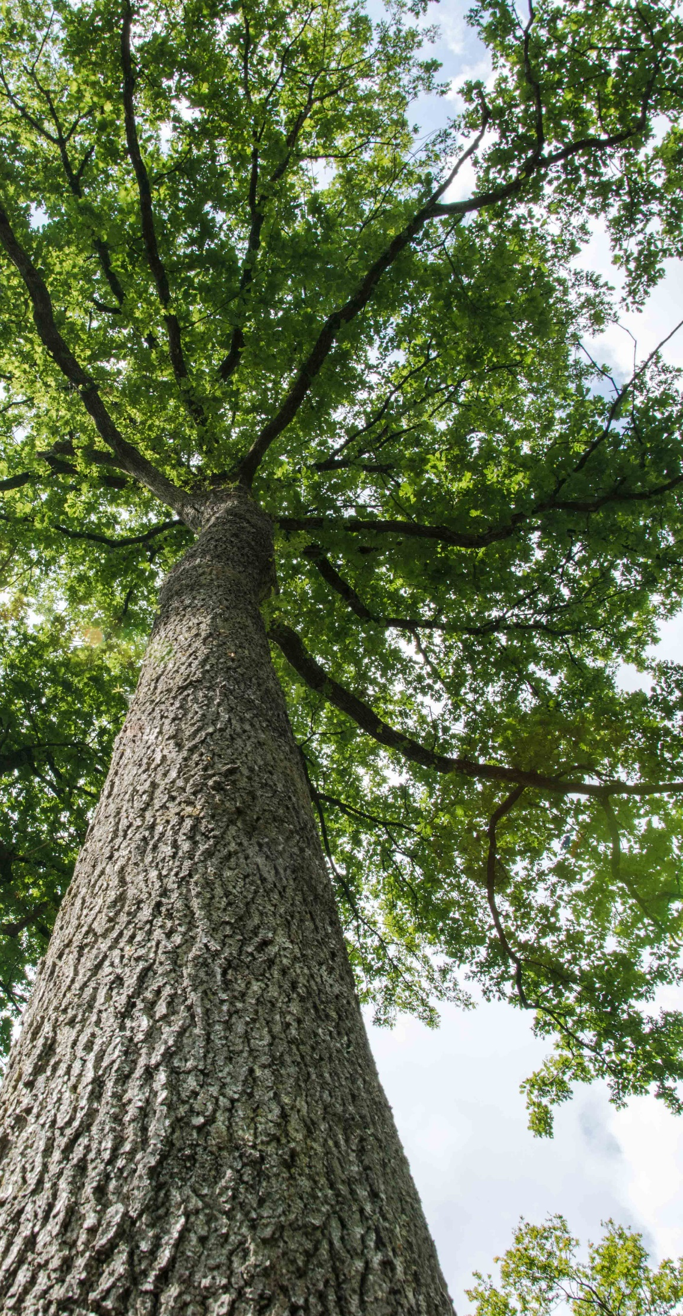
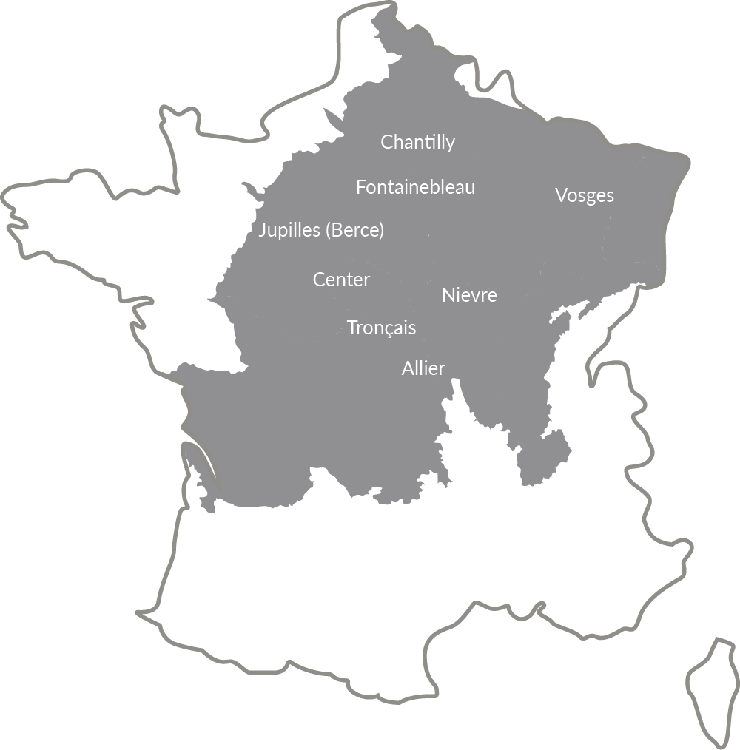
Famous Forests of France
EXCEPTIONAL FOREST
MANAGEMENT
The forests of France are renowned in the winemaking world because they have the desired tree species for cooperage and are exceptionally well managed. ‘Futaie’ management by L’Office National des Forêts leads to all, straight, fine grain oaks that are well suited to crafting barrel staves.
The majority of logs used for cooperage are sourced from Futaie Régulière managed forests which produces a tall, straight stand of trees with little difference in age and size.
Courtesy of Cooperages 1912

Slide 3
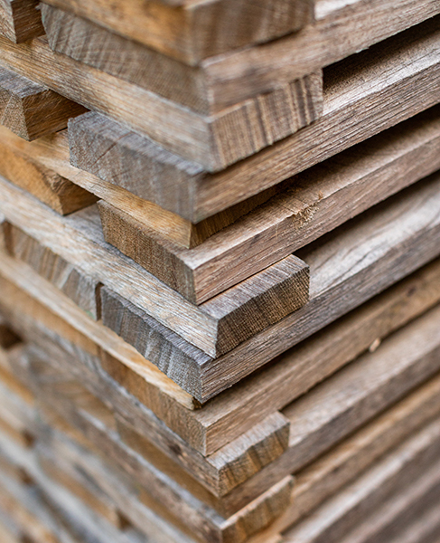
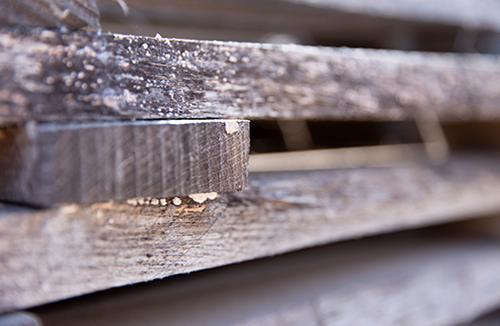
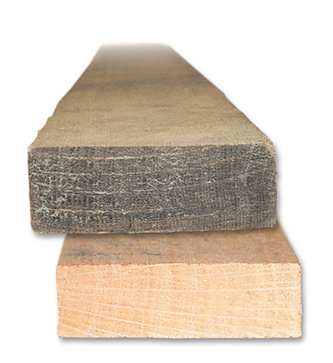
Natural Seasoning
BREAKING DOWN
OAK CONSTITUENTS
Staves are seasoned for a minimum of 24 and up to 36 months. Rain and changing weather patterns allow the natural agents (light, humidity and fungal activity) to create the seasoning effect.
Oak hemicellulose breaks into simple sugars which will later be caramelized during the toasting process.
A SEASONED (TOP)
VS FRESH CUT STAVE
(BOTTOM)
Courtesy of Cooperages 1912

Slide 4
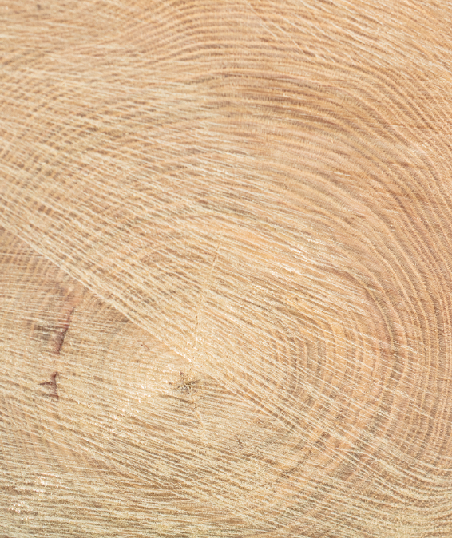
Grain
Slow-growth, fine grain oak is typically preferred for wine barrels due to its organoleptic profile, which includes softer tannins.
Poor soil quality, competition with thick undergrowth and climate create ideal growing conditions for slow growth (fine grain) trees.
FINE GRAIN
EXTRA FINE GRAIN
Courtesy of Cooperages 1912

Slide 5
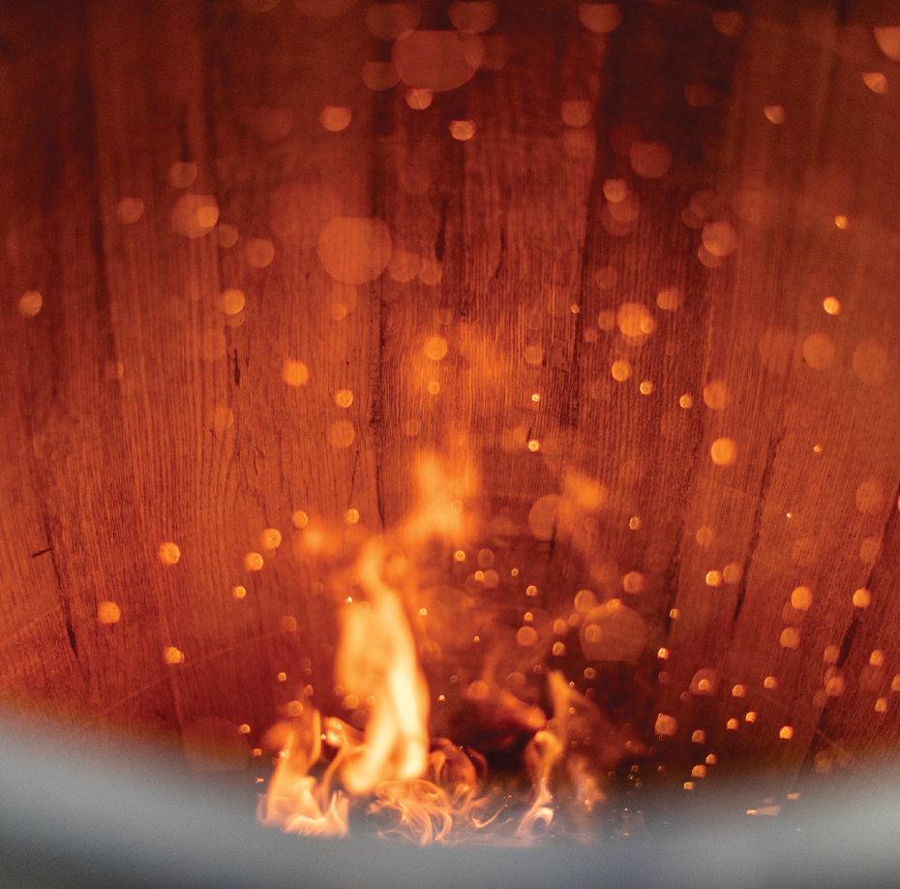
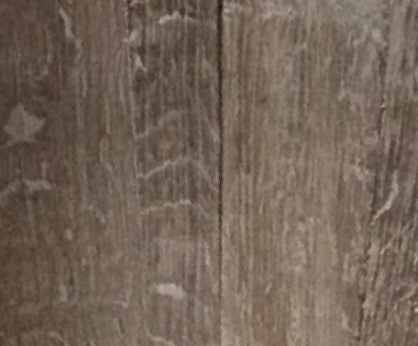
Toasting Barrels
CARAMEL
VANILLA
GRAHAM CRACKER
ESPRESSO
ALLSPICE
TOASTED BREAD
CLOVE
SWEET SMOKE
MARSHMALLOW
MOCHA
HONEY
CREATING DIFFERENT
FLAVOR PROFILES
During toasting, the chemical bonds between the major polymeric building blocks—cellulose, hemicellulose, lignin and tannin—break down to yield flavorful compounds. The extent to which extractives are formed depends
greatly on several factors, including the toasting temperature and total duration.
MEDIUM
MEDIUM LONG
MEDIUM PLUS
Courtesy of Cooperages 1912

Slide 6
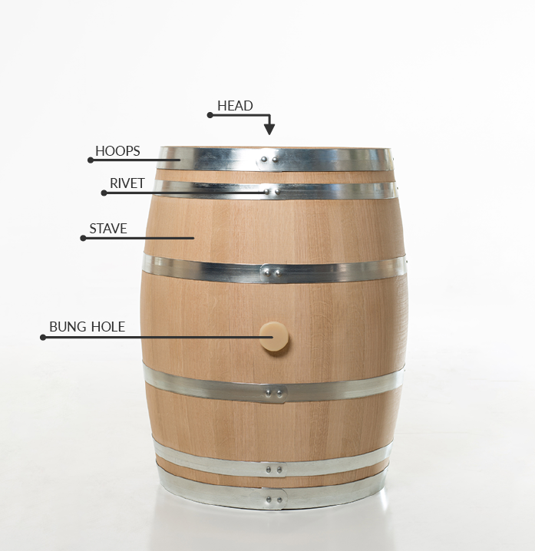
Barrel Anatomy
There are several key elements that make up the anatomy of a barrel.
HEAD The head fits tightly into the barrel to create a liquid tight seal.
HOOPS Made of steel; Barrels can have 6 or 8 hoops.
RIVET The metal bolt used for uniting the ends of the steel hoops.
STAVE Strips of wood placed edge to edge to form the sides of a barrel.
BUNG HOLE /BUNG A hole precisely drilled into the barrel for filling and emptying. The bung is a stopper placed in the bung hole.
Courtesy of Cooperages 1912

